Slide 1
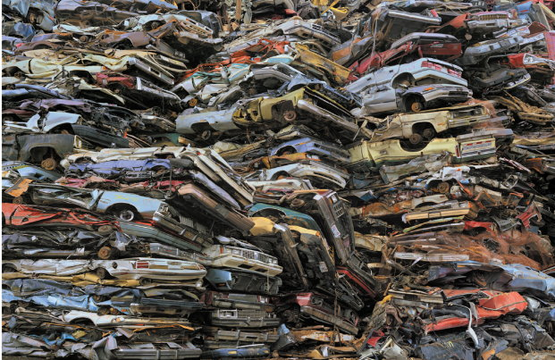
A Crash Course in Salvage and Derelict Vehicles, and other Junk
TL-35
Micah Malcolm, Duval County

Slide 2

Why does this matter?
Opportunities for Fraud:
-Steal a vehicle, take it to another state, get a valid title by submitting fraudulent documents
-Switching a VIN plate from a junked car to conceal the identity of a stolen vehicle
-Significantly damaged vehicles (junked/salvage) sold to a new consumer without disclosing the condition of the vehicle

Slide 3
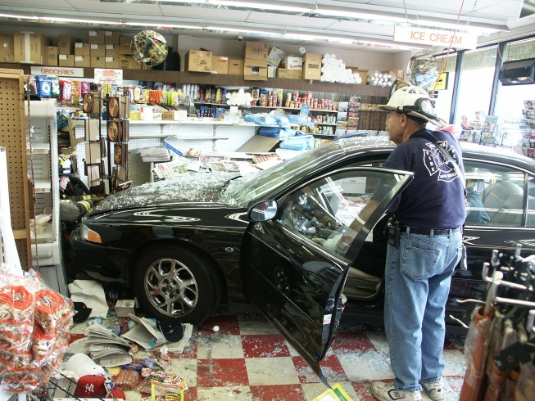
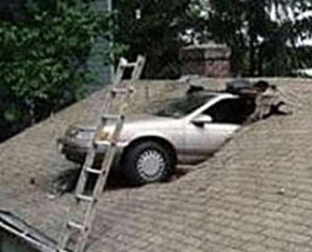
The Crash Course
Salvage Vehicles
  Understanding a Total Loss
  Rebuildable vs. Unrebuildable (CD)
Junk Vehicles
  Knowing your ‘junk’
  Useable parts of junk/salvage
Derelict Vehicles
  Salvage Dealers and
  Secondary Metals Recyclers
  Derelict Rules
  Compared to Junking
NMVTIS & Odometers

Slide 4
SALVAGE VEHICLES
Salvage is when there has been damage to a vehicle or mobile home and has been declared a total loss by an individual or an insurance company. After the vehicle is declared salvage a title can be issued based on extent of the damage to the vehicle or mobile home. Throughout this information whenever a “vehicle” is mentioned it also refers to mobiles homes.
A Rebuilt vehicle is a motor vehicle or mobile home built from salvage or junk.

Slide 5
Knowing a Total Loss…
319.30(3)(a)1,b: Total loss on an uninsured mobile home/motor vehicle that is wrecked or damaged when the cost of repairing or rebuilding is 80% or more of the cost of replacing with like kind or quality.
319.30(3)(a)1: Total loss on an insured vehicle is when insurance pays the owner to replace the wrecked or damaged vehicle with one of like kind or quality, instead of repair.

Slide 6
Knowing a Total Loss…
319.30(3)(a)(2): A vehicle is not a total loss if insurance and the owner agree to repair instead replace. If the cost to repair exceeds 100% of the replacement cost, the vehicle is branded as a ‘Total Loss Vehicle’.
319.30(3)(b): If the vehicle is equipped with custom-lowered floors for wheelchair access or a wheelchair lift, and insurance determines the vehicle is in a repairable condition for safe operation on the roads/highways, it may be submitted for a salvage-rebuildable title and a brand of ‘Insurance Declared Total Loss’.

Slide 7
When a vehicle is declared a total loss…
The owner or insurance company is to forward the title to the department within 72 hours for processing after the vehicle becomes salvage.
The salvage rule does not apply to vehicles that retail for less than $1500 in an undamaged condition.

Slide 8

Important Questions
When a vehicle is wrecked or damaged:
Is the vehicle insured?
  Is insurance going to declare it a total loss (replace rather than repair)?
  If uninsured/self-insured, will the vehicle be salvaged by the owner?
Will repairs be less than 80% of the vehicle’s current retail value (Salvage-Rebuildable), or 80% or more (Certificate of Destruction)?

Slide 9

Certificates of Destruction
AKA, Salvage Unrebuildable. The death certificate for a car.
Used to sell a motor vehicle or mobile home for parts or scrap.

Slide 10
Application
Proof of Ownership: Florida title, MCO, or out of state title
Form 82363
VIN Verification if out of state title
Lien Satisfactions
Possible sales tax if not a Florida title
If rebuildable, TL-37 describes the process.
If a Certificate of Destruction, it’s scrap.

Slide 11
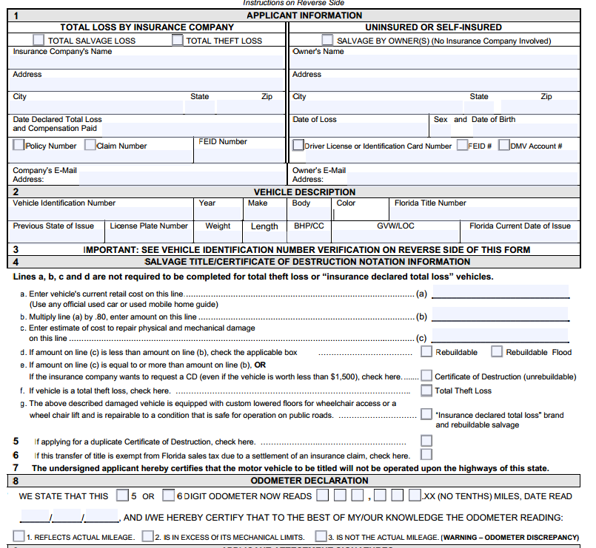

Slide 12
Rebuildable vs.
Certificate of Destruction
Determined by completing Section 4 of form 82363:
 | Vehicle A | Vehicle B
Current Retail Cost | $10,000 | $10,000
Multiply by .80 | $8,000 | $8,000
Estimated cost of repair to physical and mechanical damage | $9,500 | $3,500
Difference | $1500 | $5500
Outcome | Certificate of Destruction | Salvage Rebuildable or Salvage Rebuildable-Flood

Slide 13
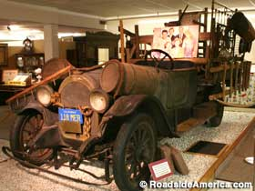
JUNK VEHICLES
What is a Junk Vehicle?
  AKA, non-repairable. Indicates a vehicle is incapable of operation on roads or highways and has no value except as a source of parts or scrap.
  Applies to mobile homes or motor vehicles
  Can be declared by an owner, insurance company, or a salvage dealer/secondary metals recycler with valid title reassignment
  Has some advantages over applying for a Derelict Motor Vehicle Certificate (Free!)

Slide 14
Various Junk/Salvage Parts used for Rebuilding
Motor Vehicles: Fenders, hoods, bumpers, cowl assembly/fire wall, rear quarter panel, trunk lid, door, decklid, floor pan, engine, frame, transmission, catalytic converter, airbag.
Truck components: Include above and truck beds, including dump, wrecker, crane, mixer, cargo box, or any bed that mounts to a truck frame.
Motorcycle major component parts: include body assembly (frame, fenders, gas tanks) engine, transmission, front fork assembly, wheels.
Mobile home parts are defined as the frame.
*Parts require bills of sale/receipts from the seller with name, address and signature (no signature needed for a business receipt) and the ID number for each component part must be shown

Slide 15
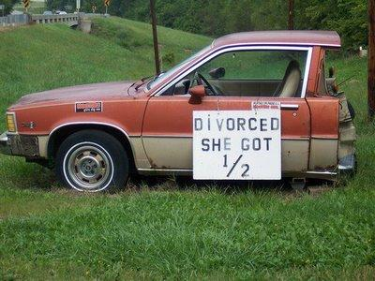
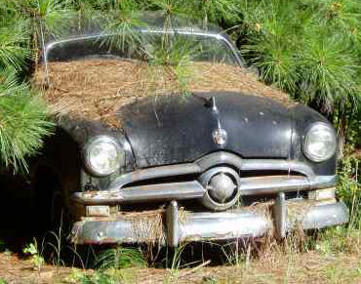
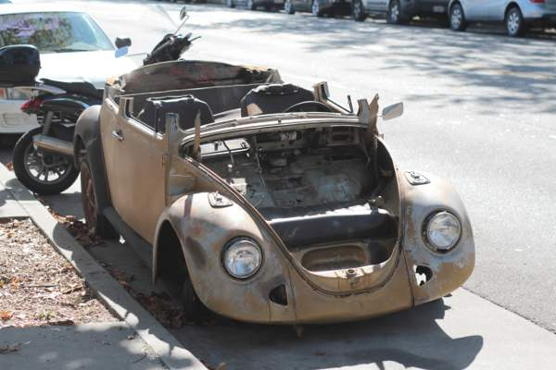
Application
Florida title must be available, with the notation “Junked” across the face.
Lien satisfactions are required.
No fee for this transaction.
If not a Florida title record, it should be submitted to the title issuing state to be junked.

Slide 16
Derelict, by the numbers…
Secondhand Dealers Registered |  | Secondary Metals Recyclers (SMRs)
Year* | # | Year* | #
2008 | 1911 | 2008 | 278
2009 | 2997 | 2009 | 580
2010 | 4498 | 2010 | 683
2011 | 4491 | 2011 | 769
2012 | 5661 | 2012 | 911
*Totals as of August of each year

Slide 17
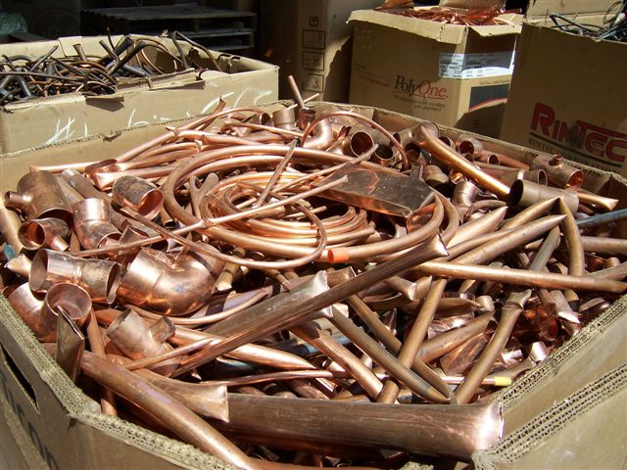

By the numbers
Only 8 counties in Florida saw a decrease in Secondary Metals Recyclers Registrations from 2011 to 2012
23 counties have at least 10 SMR’s
The top 5: Miami-Dade (102), Hillsborough (73), Duval (57), Broward (56), and Orange (49)

Slide 18


Who handles Salvage Dealers/Secondary Metals Recyclers?
Salvage Dealers have an SD license through DMS/Regional DMS offices.
Secondary Metals Recyclers are registered (DR-11S) through Department of Revenue. Local Law Enforcement can obtain reports that list names and addresses in a jurisdiction by calling
800-352-3671.
Salvage, scrap metal and recycling centers are examples of businesses that must register as secondary metals recyclers. If they acquire salvage or wrecked motor vehicles for the purpose of reselling them and their parts, they must register with DMS for a salvage motor vehicle dealer license.

Slide 19
Derelict Vehicle Applications
A Derelict Motor Vehicle Certificate may only be applied for by a Licensed Salvage Motor Vehicle Dealer (SD), or a Secondary Metals Recycler.
SD licenses are issued by the Department of Motorists Services. An SD license is used for acquiring and reselling salvaged and wrecked vehicles or their parts.
Salvage, scrap metal, and recycling center businesses must register as secondary metals recyclers (not for reselling or part sales) with the Florida Department or Revenue.

Slide 20
DERELICT VEHICLES
Defined as a motor vehicle or mobile home 10 model years old or older
Valued under $1000
In a condition that it’s highest primary value is for sale, transport, deliver to a licensed Salvage Dealer or Secondary Metals Recycler for dismantling or conversion to scrap metal
Trailers follow the same rule except they can be valued less than $5000

Slide 21
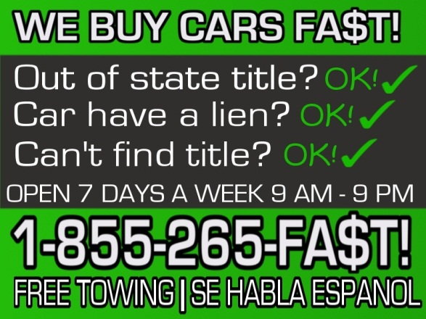
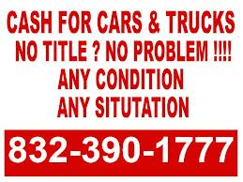

Derelict Motor Vehicle Certificate
Issued by the department to serve as evidence that the vehicle will be dismantled or converted to scrap metal.
Derelict certificates may only be reassigned once.

Slide 22
Rules about Derelicts
Seller can be the owner of record or someone assuming physical possession and responsibility and attests that possession was obtained through lawful means with all ownership rights.
Seller does not include Towing Companies (TL-26), Repair Shops (TL-25), and Landlords (TL-16) unless they obtain title or certificate of destruction in their name prior using the process outlined in the proper TL procedure.

Slide 23
Rules about Derelicts
Salvage dealers or SMR’s must make payments for the purchase of any derelict motor vehicle to the seller who is not the owner of record by check or money order. This must be made payable to the seller and not the transporter.

Slide 24
Junking versus Derelict
Junking | Derelict
Done by an owner or insurance company, Salvage Dealers and Secondary Metals Recyclers | Done by Salvage Dealers or Secondary Metals Recyclers only
Title must be available | Title does not have to be available
Must have lien satisfactions | Liens may be deleted if over 3 years old, or notice sent to lienholders to protest if 3 years old or less
Title must have reassignment completed | Age must be 10 model years old or older
No age or value requirements | Value for Vehicles and Mobile homes under $1000, Trailers under $5000
No fees | Fees

Slide 25
Application
Form 82137 and lien satisfactions.
  If a lien is 3 years old or older, it may be deleted.
  If a lien is less than 3 years old, a 10 day DV stop is placed. The department notifies the lienholder:
    If the lienholder responds, a 30 day admin stop is placed allowing for the lienholder to apply for title or a certificate of repossession.
    If the lienholder does not respond, the lien is deleted and the destruction is authorized.

Slide 26
FORM 82137
VERY IMPORTANT! The department and law enforcement rely on us to properly screen these forms.
Section 1 requires a LEGIBLE copy of the owner/seller’s Driver License or ID Card, along with their number and State of issue.
If the seller is not the owner of record, a SMUDGE-FREE right thumb print should be obtained, or another digit if no right thumb.

Slide 27
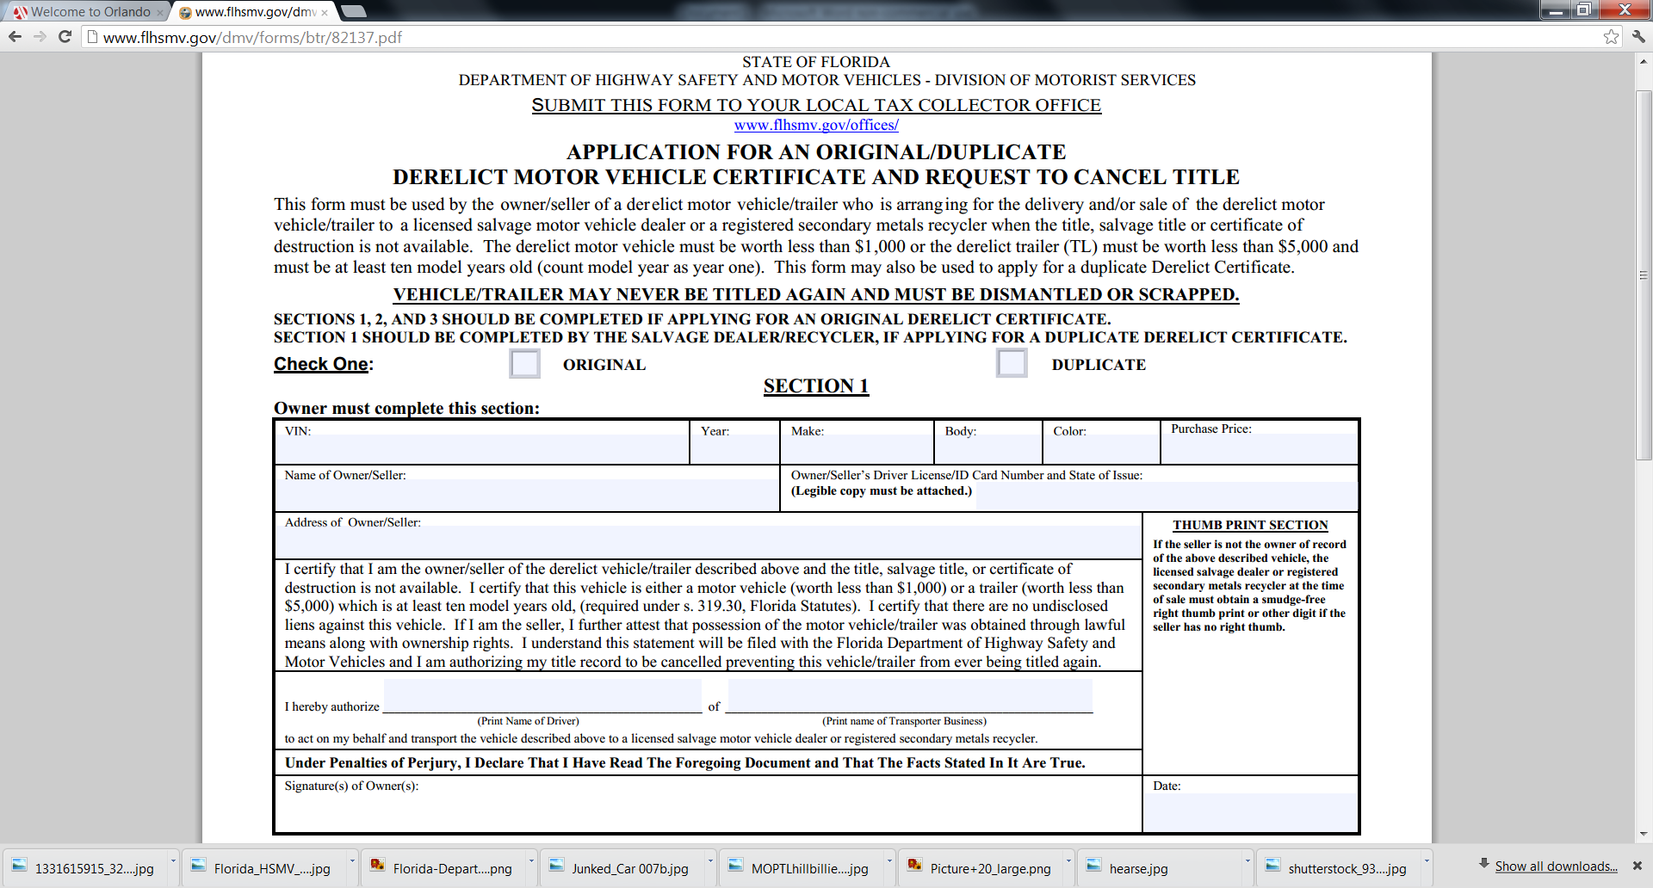
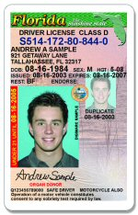
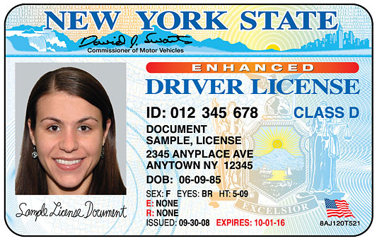


Slide 28
FORM 82137
Section 2 is completed by the transporter being hired for the owner to a licensed salvage dealer/SMR. If the owner/seller or salvage dealer/SMR transports the vehicle in lieu of a transporter, this section may be left blank.
The transporter is making a certification that section one is properly completed.

Slide 29
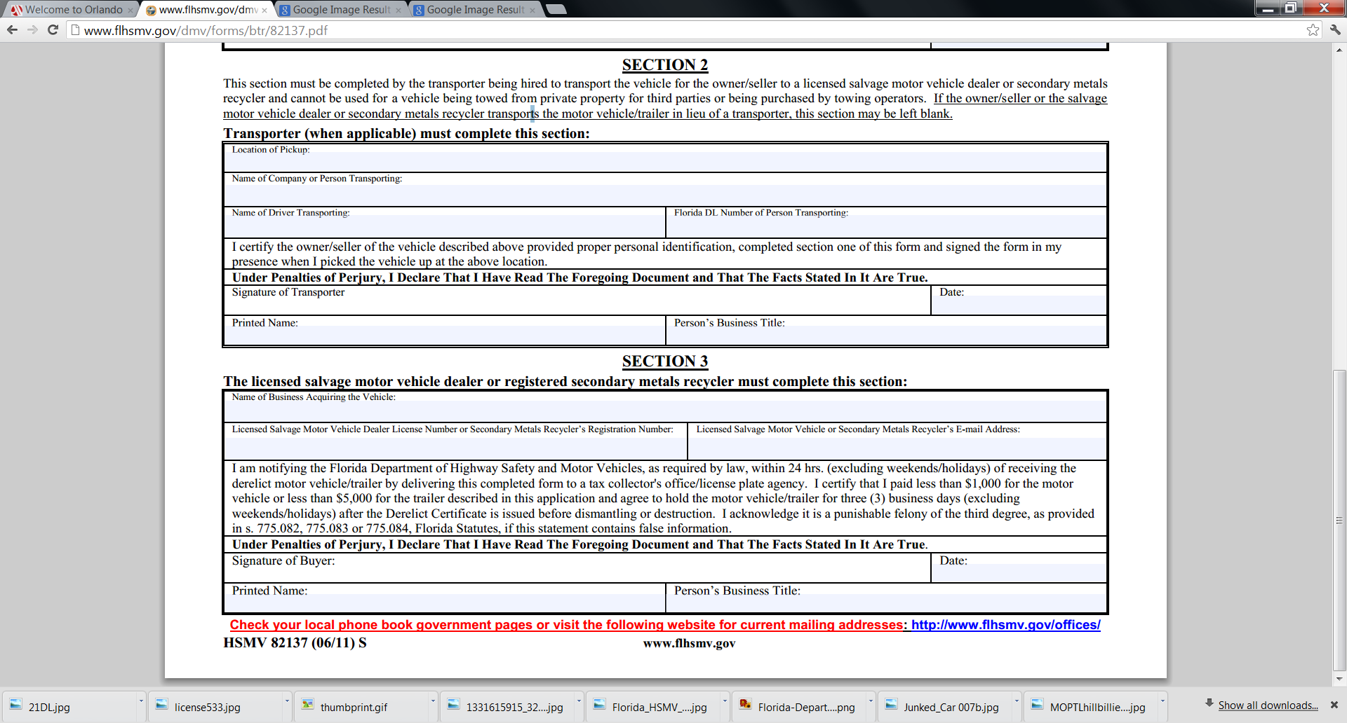

Slide 30
FORM 82137
SECTION 3 is completed by the salvage motor vehicle dealer/SMR. This should be accurately completed.
The perjury clause along with the foregoing statement would serve as necessary evidence in the event fraud is being committed.

Slide 31
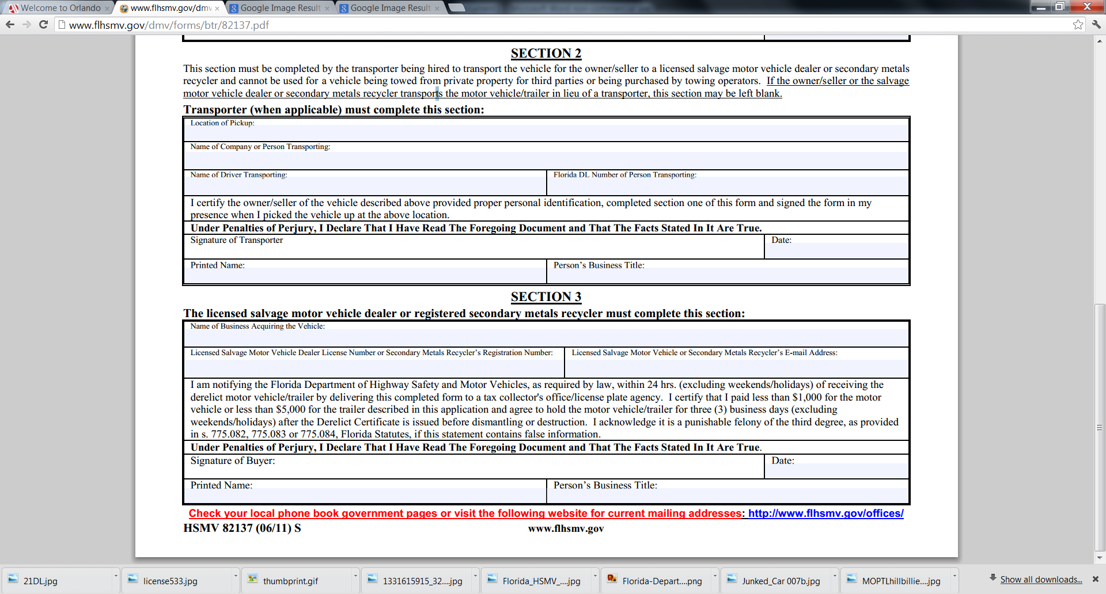

Slide 32

The role of NMVTIS
-NMVTIS checks for brands or vehicle conditions. This includes brands that may not be recorded on a title from one state, but branded in a previous state (title washing).
-NMVTIS will check for Salvage-Theft brands, or if a vehicle was junked.
-NMVTIS also allows Law Enforcement to create lists of vehicles by junk and salvage yards, or vehicles reported as junk or salvage by insurance.
-Junk and salvage vehicles are to be reported monthly to NMVTIS.

Slide 33
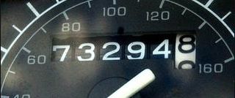
Odometer Rules
*Unless otherwise exempt (over 10 years old, GVWR > 16,000 lbs), an odometer disclosure must take place.
*True Mileage Unknown (TMU) or blank entries aren’t acceptable for non-exempt vehicles
*If the business is unable to obtain mileage for a specific reason (keys, fire), then 999,999 should be entered and ‘Not Actual’ as the certification. An affidavit must be submitted stating why the reading could not be obtained.

Slide 34
Odometer Rules Continued
*If the vehicle is exemptable, you should still try to obtain mileage but the work would not have to be rejected if the customer elects to mark as exempt.
*Omissions, Alterations, and Discrepancies still can apply, as well as the conflict of interest with a power of attorney (82053).
*Form 82995 is not limited to dealers and insurance companies, so it may be used by individuals in the circumstances of duplicate application or not-released by the lienholder.

Slide 35
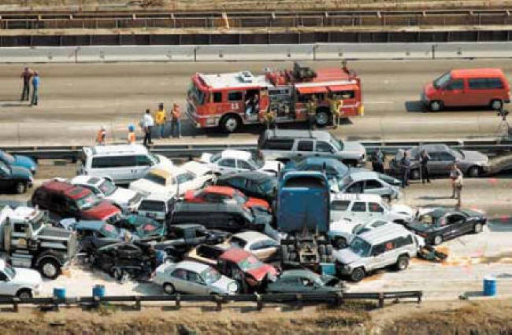
QUESTIONS?

